Slide 1
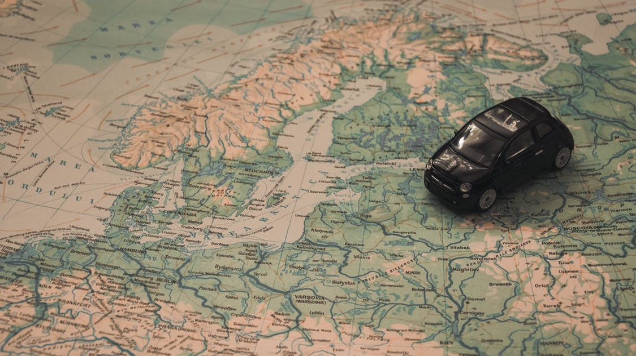
Travlendar+
Bolshakova liubov, Campagnoli Chiara, Lagni Luca

Slide 2
Main Goals
Define a Meeting
Choose the mean of transport
Define a break
Notify the user
Adapt to path changes
Optimizable and suitable solutions
Reserve a seat
Find the nearest vehicle
Take care of your planet

Slide 3
Choose the mean of transport
Goal 03. The system allows a user to choose a kind of transport among pre-defined travel means according to his/her preferences
(RE10): For each path the software must provide all the available means of transport that can be used, according to the software interfaces.
(RE11): The software must allow the user to select vehicles that he/she wants to use for the route.
(RE15): If a route is not possible because the selected travel mean is not allowed to pass a speci c place, the application must deny that option and notify the user.

Slide 4
Define a Meeting
Goal 14. The system must allow the user to create meetings with different priority
Goal 02. The system allow the user to set his/her route inside a city or a region
(RE08): The software must allow the user to choose a route (how to reach his/her destination).
(RE09): The software must allow the user to define time constraint to a specific selected route.
(RE23): The software must require the estimated time for a meeting.
(RE24): For each meeting, the system should ask the user to define its priority (1-business, 2-appointment, 3-with friends, 4-personal).

Slide 5
Define a break
Goal 04. The system allows a user to reserve a time range for a break
(RE12): The software must require the estimated time for a break.
(RE16): If a route is not possible because breaks requires too much time, the application must deny that option and notify the user.
(RE20): If a break runs out the selected time the application must notify the user.

Slide 6
Notify a user
Goal 05. The system must inform the user that a path (selected by this one) is not reachable or it's out of time
Goal 08. The system must provide information about problems/strikes for all the travel means included in the software.
Goal 09. The system must provide a user the information about weather conditions during his/her planned route.
Goal 15. The system must inform the user about upcoming meetings.
(RE14): If a route is not possible because the required time to reach the destination is not enough, the application must deny that option and notify the user.
(RE18): The software must inform the user about problems with using some transport (strikes , road damages, rain and so on) for which the usability is not guaranteed.
(RE25): The system should warn a user about the upcoming meeting twenty minutes before.

Slide 7
Adapt to path changes
Goal 16. The system must allow the user to change the part of the path during his/her trip
(RE08): The software must allow the user to choose a route.
Goal 17. The system must provide an alternative path in case of problems along the selected one
(RE17): The software must provide a User all the available solutions, according to his/her selected preferences, to get from one place to another.
(RE21): The application should avoid to make the user pass through dangerous zones of a city or a region.

Slide 8
Optimizable and suitable solutions
Goal 07. The system must provide firstly the most optimized and suitable solution, according to the user preferences
Goal 13. The system must avoid overlaps in user's scheduled travels
(RE13): If a route is not possible because of overlaps with other journeys, the application must deny that option and notify the user.
(RE17): The software must provide a User the best possible solutions, according to his/her selected preferences, to get to the meeting.

Slide 9
Reserve a seat
Goal 10. The system must provide a way to permit a user to buy a ticket for public transports.
(RE07): The software must interface with all major public transport companies that provide API.

Slide 10
Find the nearest vehicles
Goal 11. The system must provide the nearest location of a bike provided by a pre-defined bike sharing service provider.
Goal 12. The system must provide the nearest location of a car provided by a pre-defined car sharing service provider
(RE07): The software must interface with all major public transport companies that provide API.
(RE11): The software must allow the user to select vehicles that he/she wants to use for the route.

Slide 11
Take care of your planet
Goal 18. The software should show a user, if possible, the combination of travel means that minimize the carbon footprint, according to the selected path and the required time.
(RE19): The application should provide, as first option, the optimal solution according to the users' preferences about minimizing carbon footprint.

Slide 12
World and machine analysis
World
Machine
meetings scheduling
creating a new instance of Travlendar+'s classes
database queries about Client
storing routes' history
computation the fastest path
building the most ecological path
transferring a User to external services with API
generating a warning about unreachable time
generating a notification about upcoming meeting
User arranges a new meeting
User meets another person
User leaves another person
User has private travel means and/or passes for public transportation
User gets up
User moves
Shared travel mean moves
User's pass expires
There are available various travel means
Allocation of a shared transport
User's allocation
Shared travel mean is not available
Weather condition changes
Public transport reaches its final stop
Public transports are not available due to a strike or an accident
User requires a timetable of the necessary public transport route
User inserts a new appointment into the calendar
User buys a ticket or a pass for the necessary public transport
User requires booking his/her ride

Slide 13
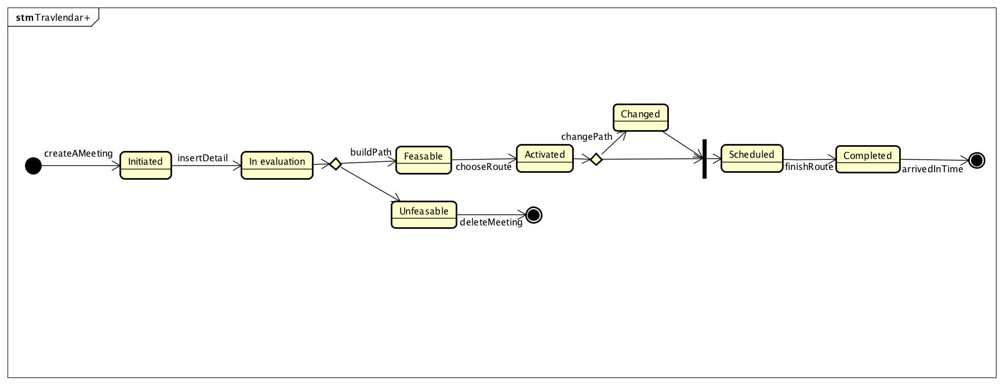
UML State Diagram

Slide 14
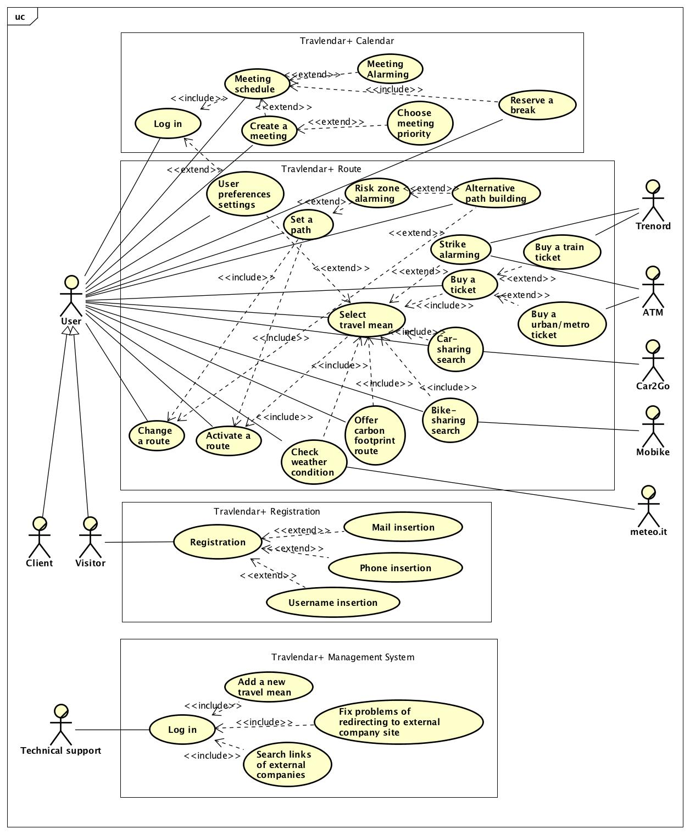
UML Use Case Diagram

Slide 15
Use cases description
User sets the path to the necessary location
Actors | Client
Goals | [G02]
Input conditions | The User is on the home page. GPS navigator is on.
Events flow | The User selects the option Set the route . User sets up the initial point using GPS localization. The User sets up the arrival point using GPS localization or specified address. The User checks if his/her current position and the arrival point has been correctly defined. The User clicks on the Confirm button. The system builds the route. The system offers the User the ways in order of increasing their length.
Output conditions | The User gets the set of available routes to reach his/her destination. The User is redirected to “Choose preferable transport means” page.
Exceptions | GPS is out of work. The User inputs the coordinates of initial and arrival point indifferent regions. The User's current position cannot be defined correctly. It's impossible to build the route inside the city/region. All exceptions are handled with notifying the issue to the User and taking back to the point 2 of Events Flow.

Slide 16
Use cases description
User buys a ticket for his/her trip
Actors | User ATM Trenord Technical support
Goals | [G10]
Input conditions | The User selects the route with using public transport except taxi
Events flow | 1. The system offers the User to buy a ticket for his/her trip. 2. The User clicks on the Confirm button. 3.1. If User selects a train, the system redirects him/her to Trenord site ( buy ticket page). 3.2. If User selects a bus/tram/metro, the system redirects him/her to ATM site ( buy ticket page).
Output conditions | The User buys the ticket on ATM/Trenord site.
Exceptions | The User does not want to buy a ticket. The exception is handled with notifying about the issue and cancelling the operation. ATM site does not work. The exception is handled with User clicking on "Cancel" button and notifying to User and Technical Support and redirecting to the Technical Support page.

Slide 17
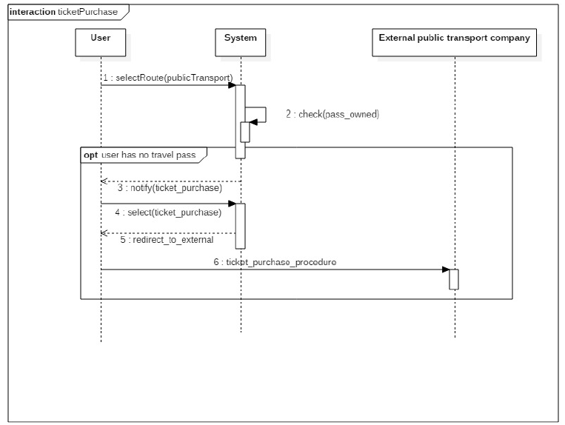
UML Sequence Diagram

Slide 18
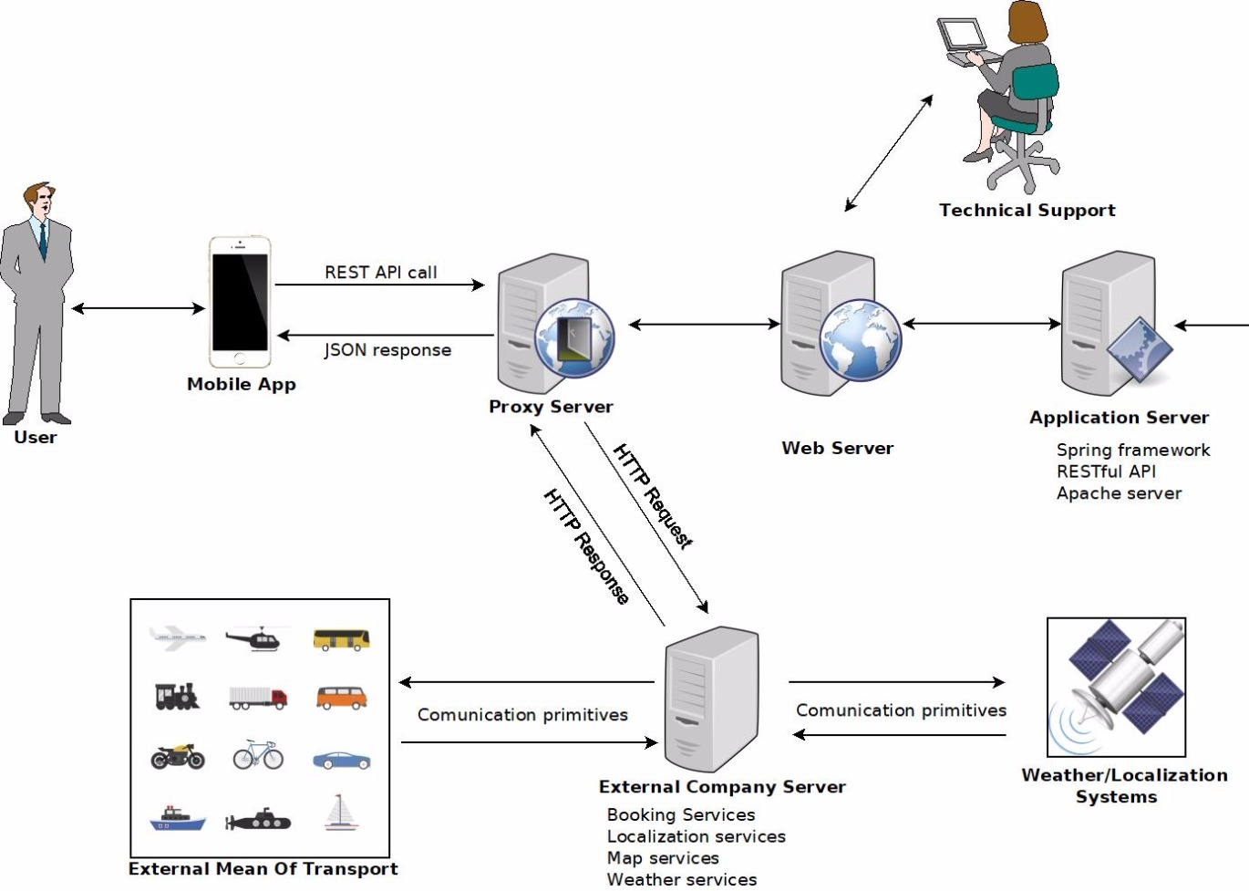
Proposed System

Slide 19
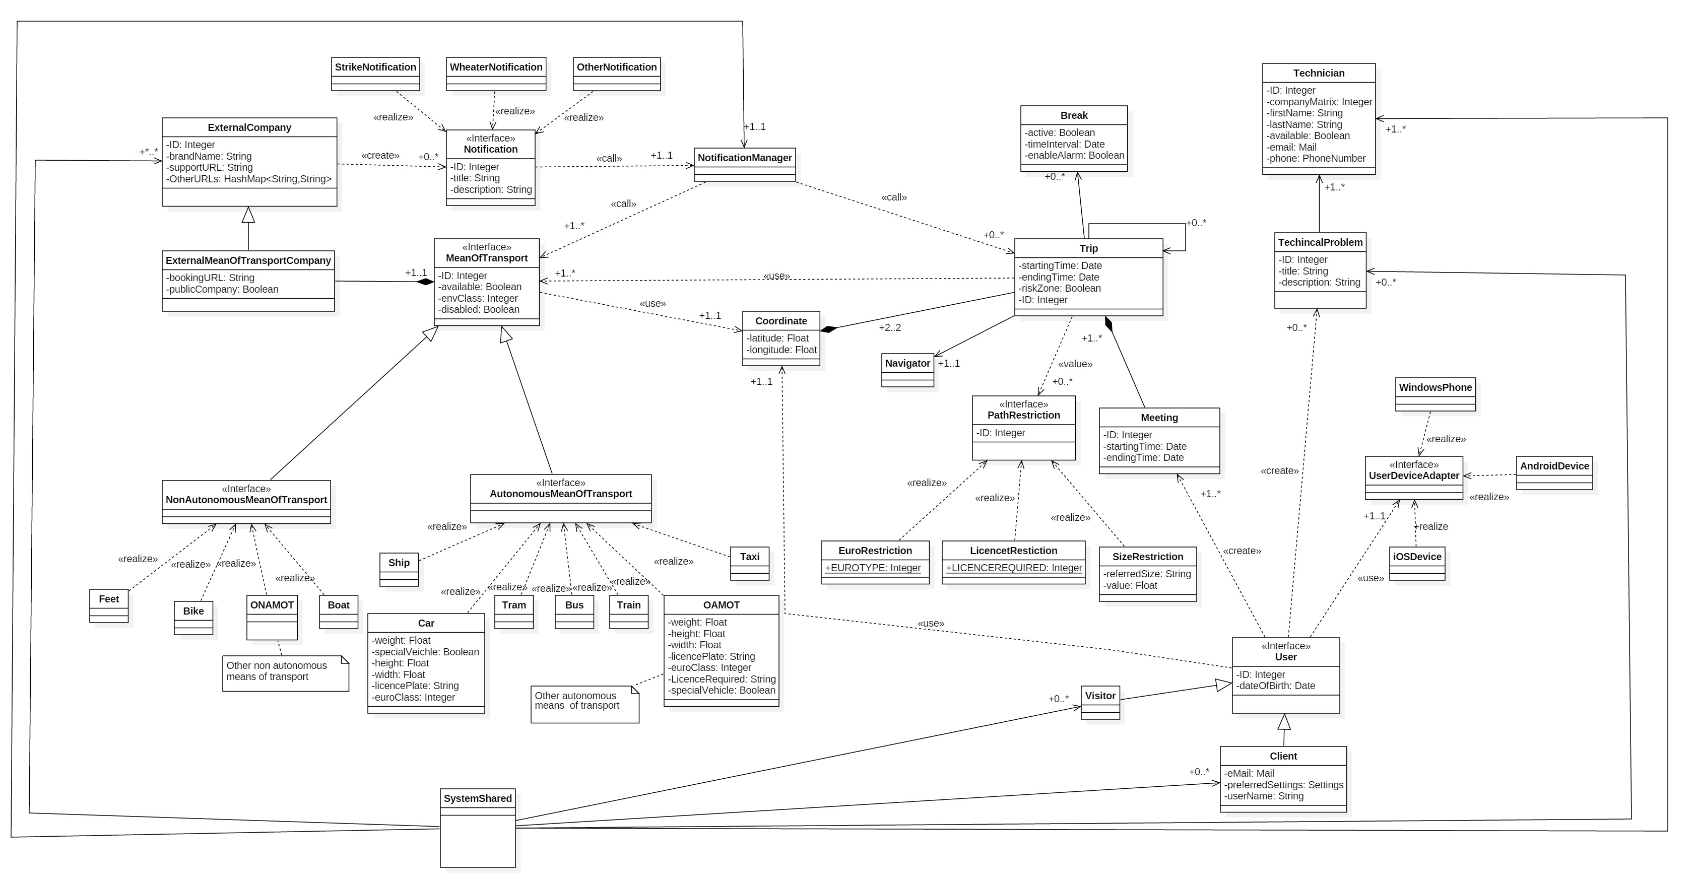
UML Class Diagram

Slide 20
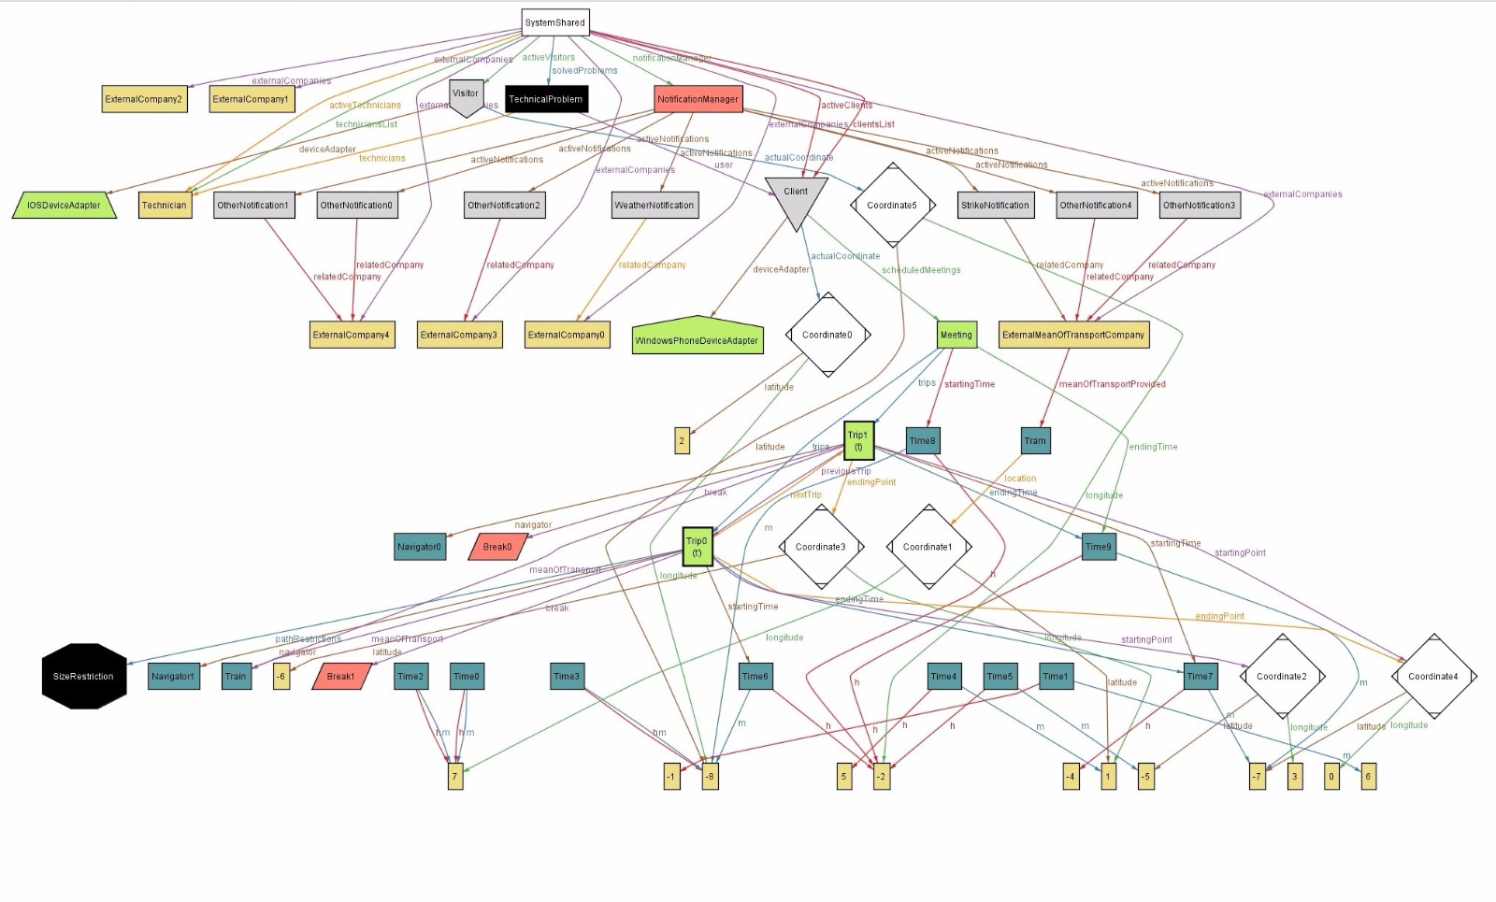
Generated world

Slide 21
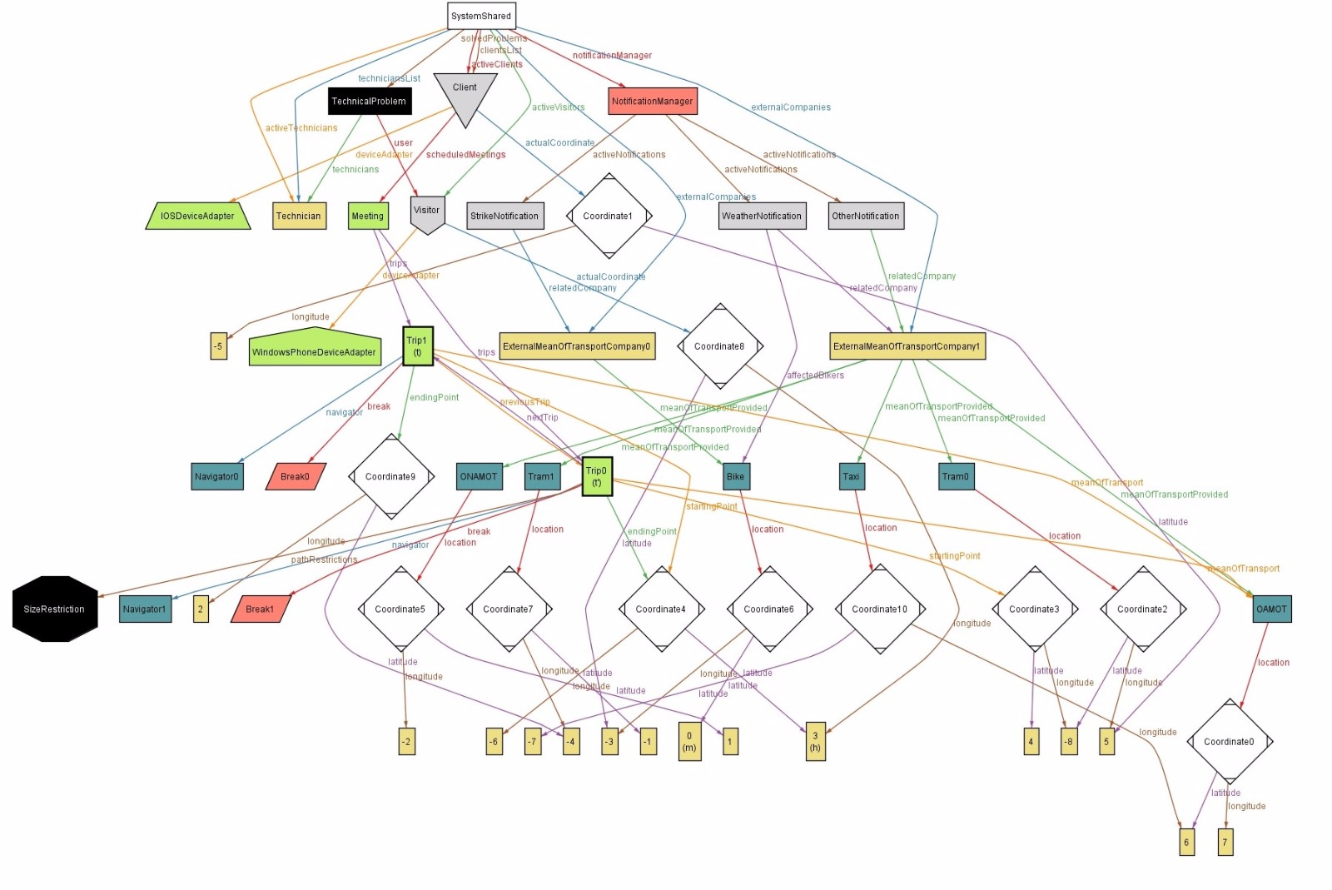

Slide 22

Thank you for your attention!
Questions?

